Slide 1

Capstone Project:
Analytical CRM Development for a Bank
Harsh Vardhan Patel

Slide 2

Customer relationship management (CRM)
Customer relationship management (CRM) refers to the principles, practices and guidelines that an organization follows when interacting with its customers. From the organization’s point of view, this entire relationship encompasses direct interacting with customer, such as sales and service-related processes and forecasting and analysis of customer trends and behaviors. Ultimately CRM services to enhance the customer’s overall experience.

Slide 3
Data Overview:
Understanding Your Customer Base: Analyze demographics like age, income, and location to identify churn patterns within specific customer segments. This helps tailor retention strategies to resonate with different groups.
Predicting Who Might Leave: Leverage transaction data and customer exit information to build models that predict churn risk. Early identification allows for proactive interventions to address potential issues before customers leave.
Identifying Reasons for Churn: Analyze why customers leave the bank. This could be high fees, limited services, or inconvenient processes. Understanding these pain points helps address them and prevent future churn.
Learning from Satisfied Customers: Analyze profiles of happy customers to identify factors driving their satisfaction. This could be loyalty programs, personalized communication, or efficient service. Replicating these elements can improve overall customer experience.
Taking Actionable Steps: Based on your analysis, recommend targeted strategies. This might involve offering fee waivers to at-risk customers, simplifying processes, or developing new products based on identified needs.

Slide 4






CRM Six elements
Customer Acquisition
Maintaining CRM through
General Policies
Customer acquisition and retention can be practiced by the firms in a well-established manner than ever before.
CRM through General Policies it is found that the bank employees posses
Customer Satisfaction
Implementation of CRM
The banks should concentrate highly on the valid elements of their CRM strategy for generating customer satisfaction and customer loyalty
Implementation of CRM poses a greater challenge to the banks after acquiring the customers.
Customer Loyalty
Maintaining CRM through
Specific Strategies
Loyalty is considered to be the ultimatum as far as CRM is concerned.
CRM through General Policies it is found that the bank employees posses

Slide 5
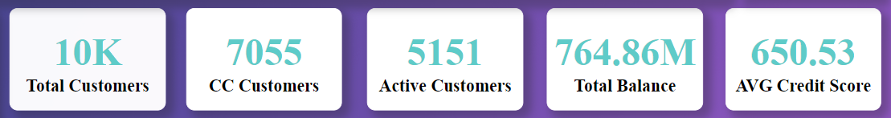
KPIs :
Bank boasted a diverse customer base of 10,000 individuals. Among them, 7,055 were credit card holders, signifying a strong product uptake.
However, active engagement was lower, with only 5,151 regularly using their cards. These active users collectively managed a substantial total balance of $764.86 million.
Despite the impressive financial activity, the average credit score among all customers was moderately positioned at 650.53, indicating a mix of both fiscal prudence and challenges within the customer base.

Slide 6
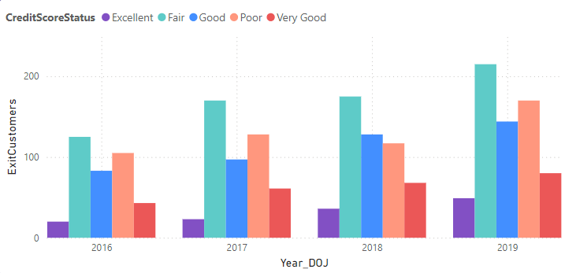
The graph shows a bank attracting new customers across credit scores between 2016 and 2019. Most new customers came in 2019, with a healthy mix of “Excellent” and “Fair” credit scores. It’s clear how many customers left the bank (Exit Customers) based on this graph. However, it does show the number of customers who joined in a given year based on their credit score when they first joined. Overall, this suggests the bank has been successful at attracting new customers, but we can’t say for sure if they are retaining them.

Slide 7
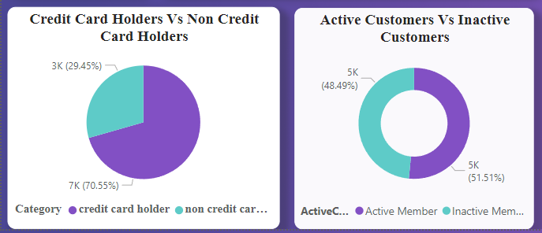
The pie chart shows two groups of customers: active and inactive credit card holders.
In 2019, there were more active customers (48.49%) than inactive customers (29.45%). This suggests that the bank might be doing well at retaining customers.

Slide 8
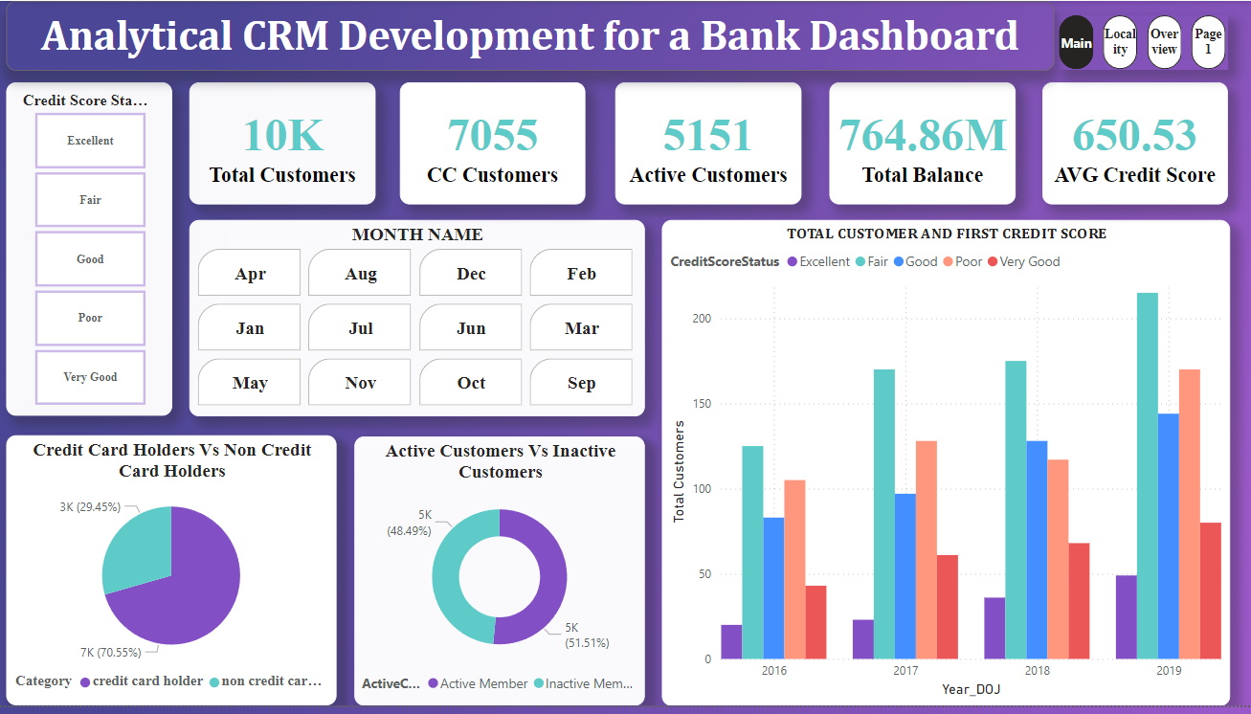

Slide 9
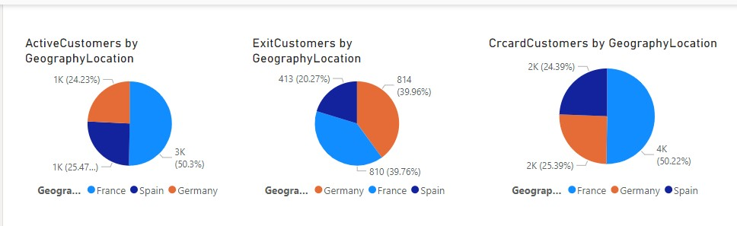
The two pie charts show the distribution of active customers, credit card customers, and exiting customers by geographic location.
The majority of active customers (50.3%) and credit card customers (39.96%) are located in unspecified geographic locations.
Spain and Germany are the only two specified locations shown, with a similar number of active customers (around 1,000 each).

Slide 10
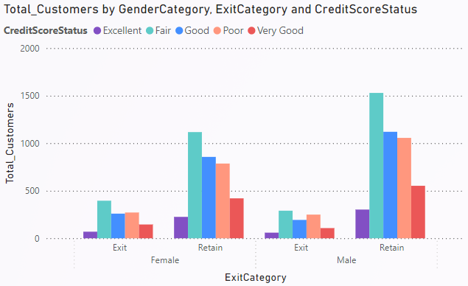
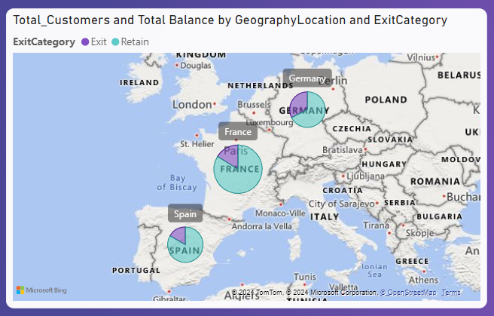
Exit category likely refers to whether a customer is leaving or staying with the company. Overall, there are more females than males across all credit score statuses and exit categories.
Within the female category, there are more customers who are exiting with a fair credit score (395) than any other status. For males exiting, there are also more with a fair score (290) than any other status.
France has the most total customers (4,204) followed by Spain (2,508) and Germany (2,509).
The data shows the number of customers by country and whether they are exiting or being retained. In total there are 7,717 customers.
France has the most customers exiting (810) followed by Germany (814) and Spain (413).

Slide 11
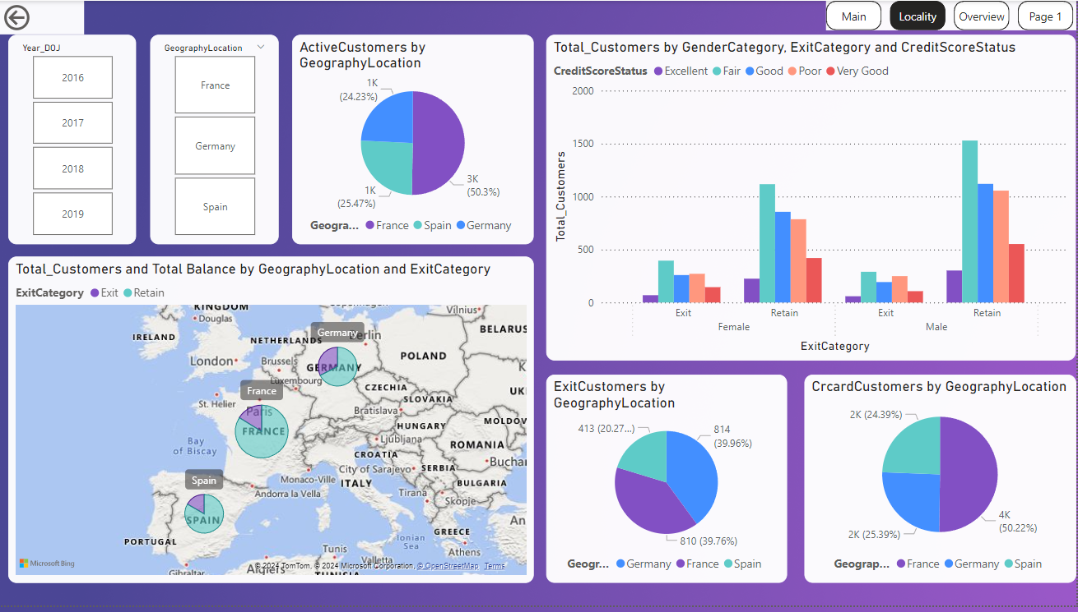

Slide 12
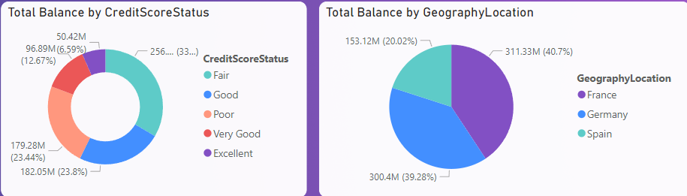
France has the highest total balance at €311,332,479.50.
The Pie chart lists total balance by country (France, Germany, Spain).
Germany has the second highest total balance at €300,402,861.40.
The credit score with the highest total balance is "Fair" at $256,218,721.70.
The data shows a credit score status and the corresponding total balance.
It is important to note that a high credit score does not necessarily correlate with a low total balance.

Slide 13
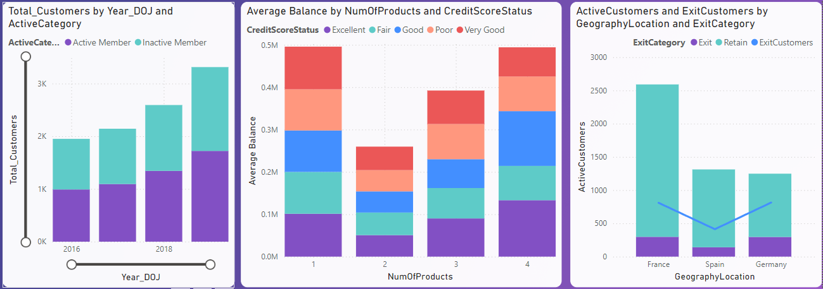
The table shows the number of active customers by country. France has the most active customers (2293). Spain has 1171 active customers.
The table shows the total number of customers by country for the years 2016, 2017, 2018 and 2019. France has the most customers (4,204). Germany and Spain each have around 2,500 customers.
For instance, companies with an "Excellent" credit score have an average balance of $133,217.87, while companies with a "Poor" credit score have an average balance of $81,686.99.
However, there are exceptions to this trend. For example, one company with a "Fair" credit score has a higher average balance ($101,224.52) than some companies with an "Excellent" credit score.

Slide 14
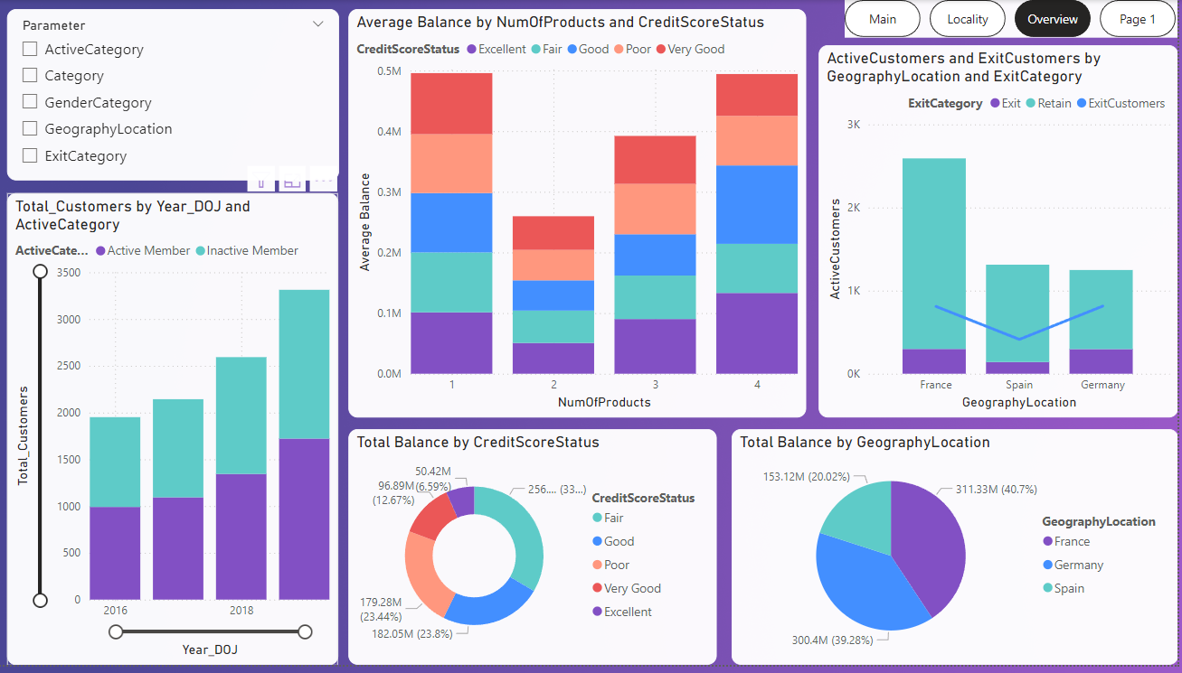

Slide 15
Conclusion
Deep Dive: By analyzing demographics, transactions, and churn data (age, products, location), we can pinpoint factors driving customer departures.
Targeted Retention: Identify high-risk customers (low balances, inactive accounts) and prioritize personalized retention campaigns.
Incentivize Loyalty: Offer relevant products (credit cards, high-yield savings) based on customer needs and profiles to increase satisfaction and value.
Service Enhancements: Leverage insights on churn drivers (long wait times, limited products in specific regions) to improve service delivery and product offerings.
Continuous Monitoring: Track the effectiveness of retention strategies (customer response rates, churn reduction) to refine approaches and maximize customer lifetime value.

Slide 16


